Slide 1

eInvoicing Global
EDICOM E-Invoicing Solution

Slide 2

EDICOM
How we work in Edicom

Slide 3

Team contacts
EDICOM PM
B2B Integration Solutions
Solutions
by Industry
Main Role:
International Project Manager for EDI and VAT compliance projects
Working time:
Monday to Friday
8:00am to 2:00pm CET
2:30pm to 17:00pm CET
Contact information:
Email: @edicomgroup.com
Tel. : 34 961 367 100 ext.
Based in
Qualified Trust Services
Global Compliance
NHS
e-Procurement Strategy

Slide 4
Team contacts
HOW WE WORK
In Edicom
B2B Integration Solutions
Solutions
by Industry
Organization for projects:
Team of consultants available for projects
Mainly based in Spain
Weekly sprints
Every Wednesday the project planning of the following sprint is revised and adjusted
Main consultant details:
Email: @edicomgroup.com
Tel. Es: 34 961 367 100 ext.
Based in
Qualified Trust Services
Global Compliance
NHS
e-Procurement Strategy

Slide 5

Corporate Overview
eInvoicing in Malaysia

Slide 6

Malaysia: eInvoicing
Implementation of eInvoicing
Tax authority: Inland Revenue Board (IRB)
E-Invoice Guideline Year 2023 published: 21st July 2023
Version 2.1. published on 28th October 2023
Version 2.2. published on 9th February 2024
SDK (beta version) published on 9th February 2024
Version 2.3. published on 6th of April
SDK version 1.0. published on 6th of April
Malaysia
Implementation of eInvoicing
To whom does it apply?
All taxpayers undertaking commercial activities in Malaysia as listed under section 1.3. of the Guideline
Both local and international transactions
B2B, B2C and B2G transactions
Notes:
The Inland Revenue Board (IRB) had already announced the e-Invoicing initiative with deadlines starting in June 2024 (recently modified to August 2024).
On the 21 July 2023 they published the E-Invoice Guideline Year 2023. Official Guideline published by the Tax Authority
The tax authority in Malaysia is yet to provide a comprehensive overview of the new e-invoicing regulation (“SDK”)

Slide 7
Malaysia: eInvoicing
Deadlines
August 1st 2024: for taxpayer with an annual turnover or revenue over RM100 Million (approx. 20 Million Euros)
January 1st 2025: for taxpayer with an annual turnover or revenue over RM25 Million (approx. 5 Million Euros)
July 1st 2025: all taxpayers and certain non-business transactions
* Taxpayers can opt to voluntarily participate in the implementation at an earlier date
Malaysia
Implementation of eInvoicing
Notes:
MYR = Malaysian Ringgit, 1 MYR = 0.20 €

Slide 8
Malaysia: eInvoicing
Highlights
Invoice legal format: XML/JSON
Authentication through a Digital Certificate issued by CA
Connectivity through API
Clearance by IRB: Unique Identifier Number (UID) + Log ID
Cleared invoice to be delivered to the buyer with QR code
Rejection/cancellation of the invoice within 72 hours
After 72-hour timeframe: credit note / debit note / refund invoice
Malaysia
Implementation of eInvoicing

Slide 9
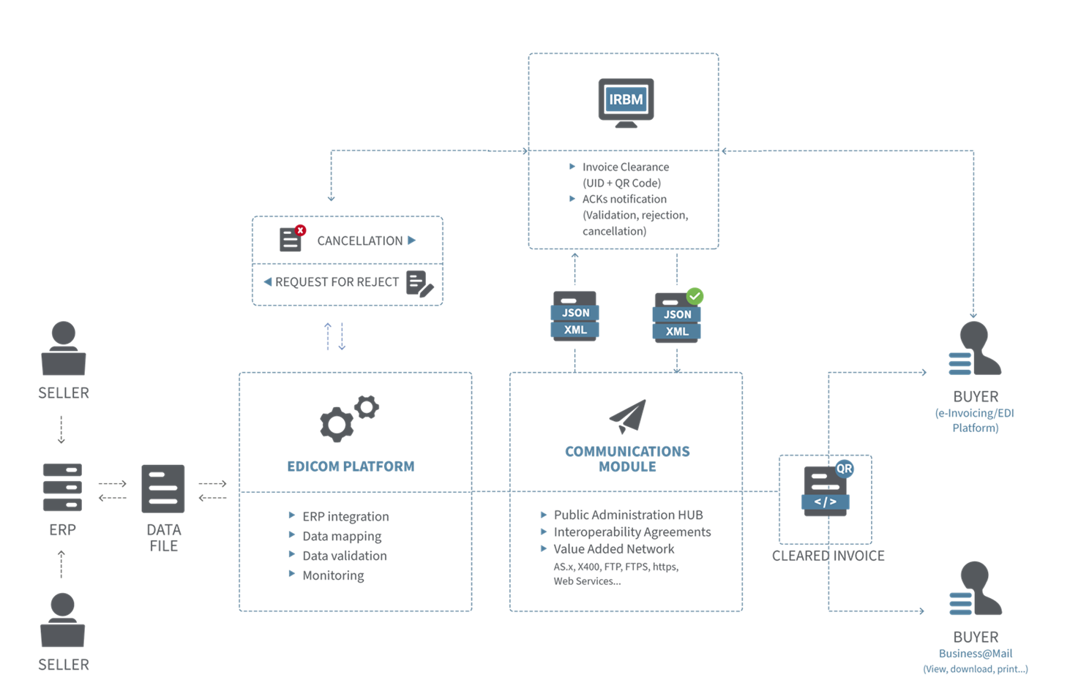
Malaysia: eInvoicing
Notes:
Issuance of the invoice: when a sale is concluded, the supplier creates the e-invoice to be submitted to the IRBM.
For this, there are currently data fields, grouped into 9 categories that are required to issue an e-invoice (next slides)
Data transmission: communication protocol with Edicom, structured format
Data mapping: JSON/XML
Data validation: mandatory/conditional/optional fields
Once the invoice is validated, it will be securely communicated to the IRB via API using the authentication mechanisms via the Digital Certificate issued by the IRBM to the taxpayers.
Clearance of the e-invoice. The IRB will validate the e-invoice in realtime and return the validation link (UUID and Log ID) to the supplier to create the QR Code
In parallel, there will be notifications (acknowledgements) from the IRBM to the supplier as well as to the buyer.
This would be the first step – the clearance of the invoice.
The next step is to send the cleared invoice (with QR code) to the buyer. The purpose of the QR code is to validate the existence or the status of the e-Invoice, which can be checked through the IRBM’s official portal. This delivery can be done also in an automated manner, to buyers with e-Invoicing capabilities and to buyers that can only receive the PDF version, to make this whole flow fully traceable from your company’s perspective.
Additionally, this model allows for the rejection or cancellation of the e-invoice. The supplier/buyer can cancel/reject an invoice within 72 hours with justification (e.g. wrong invoice data in any field (e.g., SST number, business registration number, any business-related information, etc ) via the IRBM portal. Both will receive a notification.
Request for Reject notification / 7. Cancellation notification
After the 72-hour timeframe, the status of the e-Invoice will automatically change to “Valid”, and any further amendments will require Debit/Credit Note.
It is important to note that there might be some final tweaks to this model as the final specifications will be released in the upcoming budget, as well as the SDK (Software Development Kit) that is expected to be issued in the Q4 later this year.
In any case, Edicom’s global solution will always be in line with the requirements in Malaysia

Slide 10

Malaysia: eInvoicing
Mandatory fields
1 | Supplier´s Name | 29 | Description of Product or Service
2 | Buyer´s Name | 30 | Unit Price
3 | Supplier´s TIN | 31 | Tax Type
4 | Supplier’s Registration / Identification Number / Passport Number | 32 | Tax Rate
5 | Supplier´s SST Registration Number | 33 | Tax Amount
6 | Supplier’s Tourism Tax Registration Number [Mandatory for tourism tax registrant] | 34 | Details of Tax Exemption [Mandatory if tax exemption is applicable]
7 | Supplier’s e-mail | 35 | Amount Exempted from Tax [Mandatory if tax exemption is applicable]
8 | Supplier’s Malaysia Standard Industrial Classification (MSIC) Code | 36 | Subtotal
9 | Supplier’s Business Activity Description | 37 | Total Excluding Tax
10 | Buyer’s TIN | 38 | Total Including Tax
11 | Buyer’s Registration /Identification Number / Passport Number | 39 | Total Net Amount [Optional, where applicable]
12 | Buyer’s SST Registration Number (Mandatory for SST registrant) | 40 | Total Payable Amount
13 | Buyer’s e-mail | 41 | Rounding Amount [Optional, where applicable]
14 | Supplier’s Address | 42 | Total Taxable Amount per tax type [Optional, where applicable]
15 | Buyer’s Address | 43 | Quantity [Optional, where applicable]
16 | Supplier’s Contact Number | 44 | Measurement [Optional, where applicable]
17 | Buyer’s Contact Number | 45 | Discount Rate [Optional, Where Applicable]
18 | e-Invoice Version | 46 | Discount Amount [Optional, where applicable]
19 | e-Invoice Type | 47 | Fee / Charge rate [Optional, where applicable]
20 | e-Invoice Code / Number | 48 | Fee / Charge amount [Optional, where applicable]
21 | Original e-Invoice Reference Number [Where applicable] | 49 | Payment Mode [Optional]
22 | e-Invoice Date and Time | 50 | Supplier's Bank Account Number [Optional]
23 | Issuer’s Digital Signature | 51 | Payment Terms [Optional]
24 | Invoice Currency Code | 52 | Prepayment Amount [Optional]
25 | Currency Exchange Rate [Where applicable] | 53 | Prepayment Date [Optional]
26 | Frequency of Billing [Optional, where applicable] | 54 | Prepayment Reference Number [Optional]
27 | Billing Period [Optional, where applicable] | 55 | Bill Reference Number [Optional]
28 | Classification
Malaysia
Data requirements for e-invoice

Slide 11
Malaysia: eInvoicing
Additional Mandatory fields
Applicable to transactions where goods are shipped to a different recipient and/or address (i.e. different from the buyer’s details) |  | Applicable to export and import transactions
1 | Shipping Recipient’s Name | 1 | Reference Number of Customs Form No.1,9, etc
2 | Shipping Recipient’s Address | 2 | Incoterms
3 | Shipping Recipient’s TIN
4 | Shipping Recipient’s Registration / Identification Number / Passport Number
Additional Optional fields
Applicable to export and import transactions
1 | Product Tariff Code [Only applicable to goods]
2 | Free Trade Agreement (FTA) Information [For export only, if applicable]
3 | Authorisation Number for Certified Exporter (e.g., ATIGA number) [For export only, if applicable]
4 | Reference Number of Customs Form No.2
5 | Country of Origin
6 | Details of other charges
Malaysia
Data requirements for e-invoice

Slide 12

DEMO

Slide 13
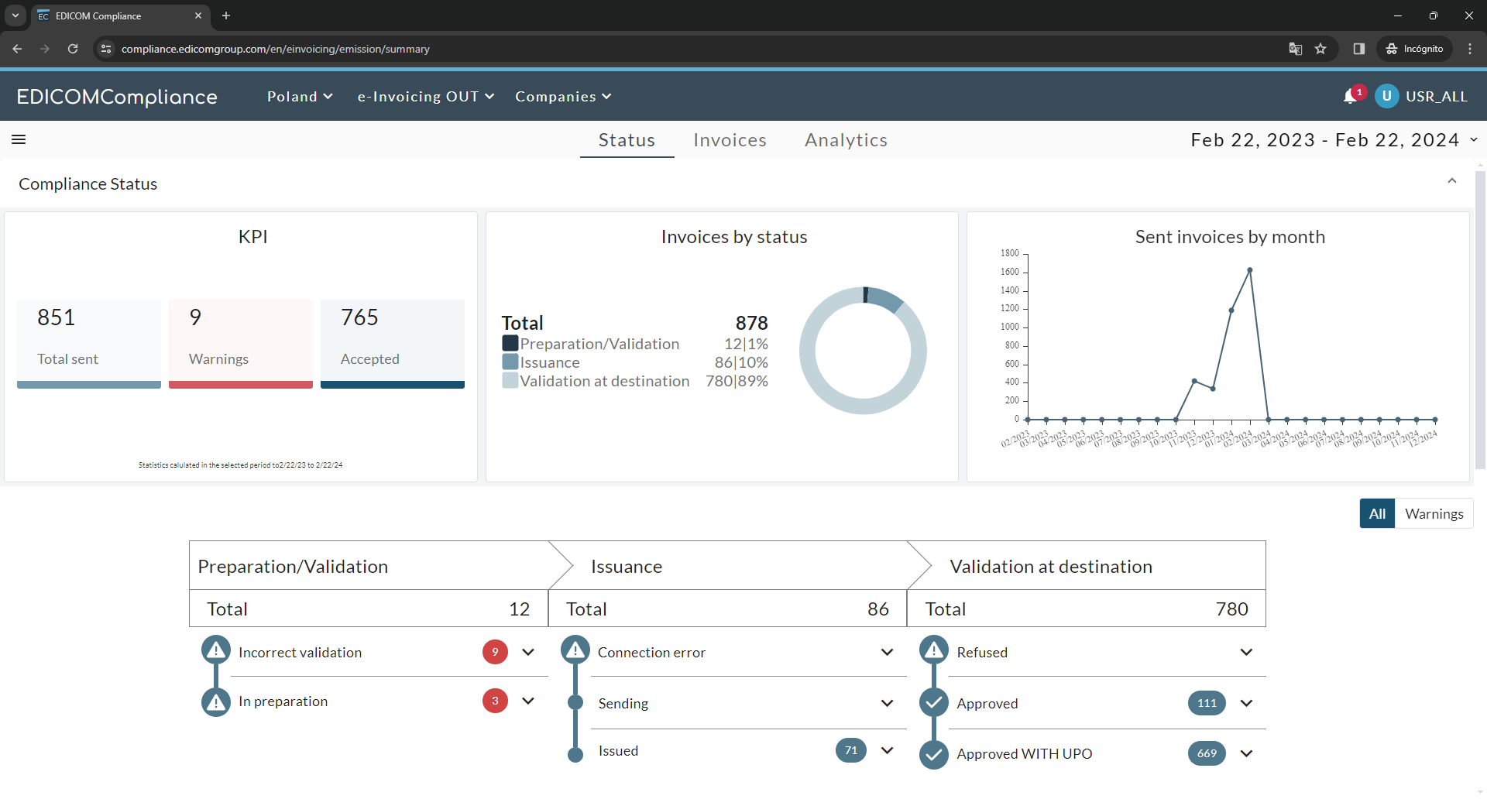
EDICOMCompliance
Notes:
EDICOMCompliance operates as a blackbox with an available front-end accesible for a secure and user friendly monitoring of the flows. It allows to see the flows per country (e.g. Poland), type of flows (e.g. AR invoices) and per entity.
EDICOMCompliance allows to monitor the lifecycle of the document (e.g. invoice). In the case of e-Invoicing, an invoice may pass through various phases: preparation/validation (mapping of the structured data, syntactical validation by EDICOM); issuance of the legal e-invoice (sending, error in connecting to the KSeF, issued correctly); Validation at destination (refused, approved, approved with UPO).

Slide 14
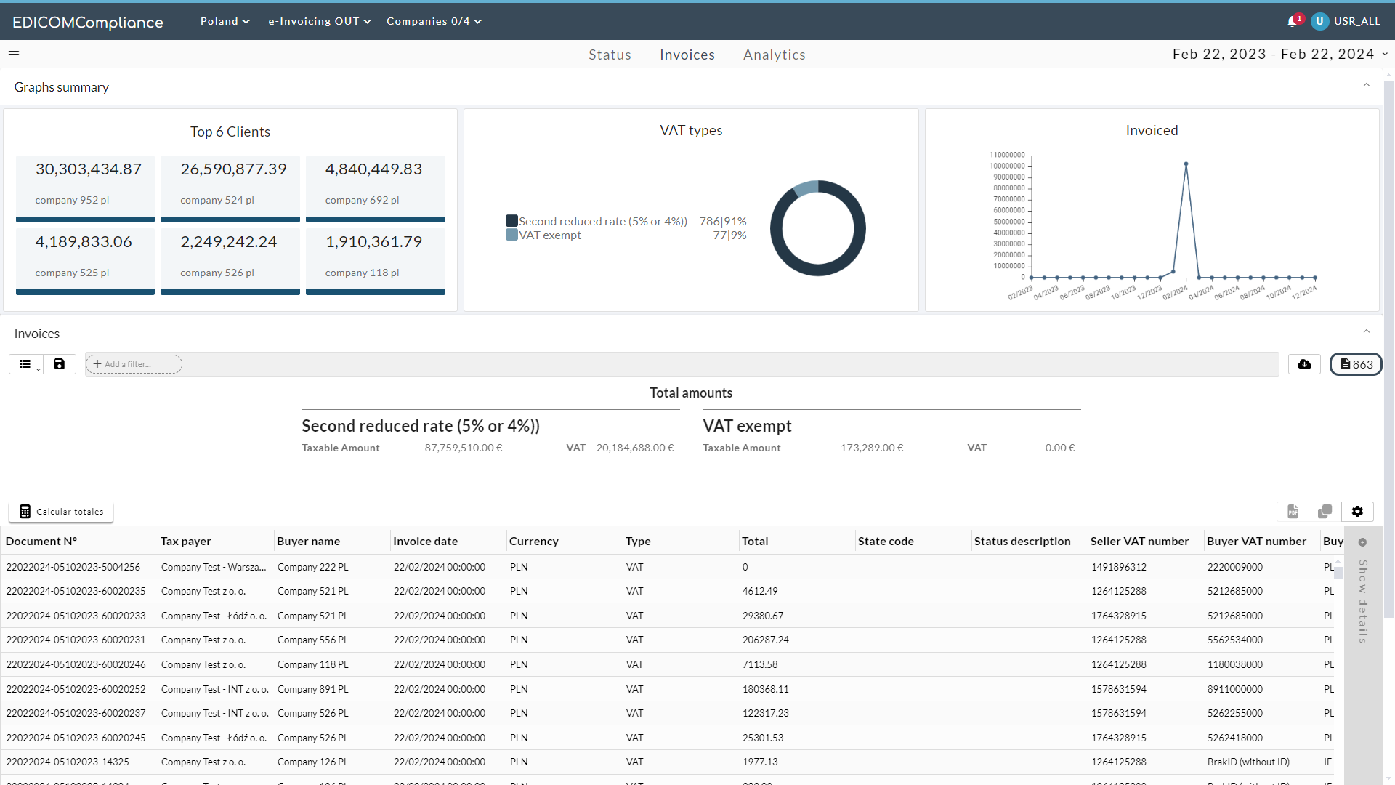
EDICOMCompliance
Notes:
The dashboard provides a quick and easy access to invoices sent, received, and erroneous invoices, as well as to the acknowledgments associated with these invoices.

Slide 15
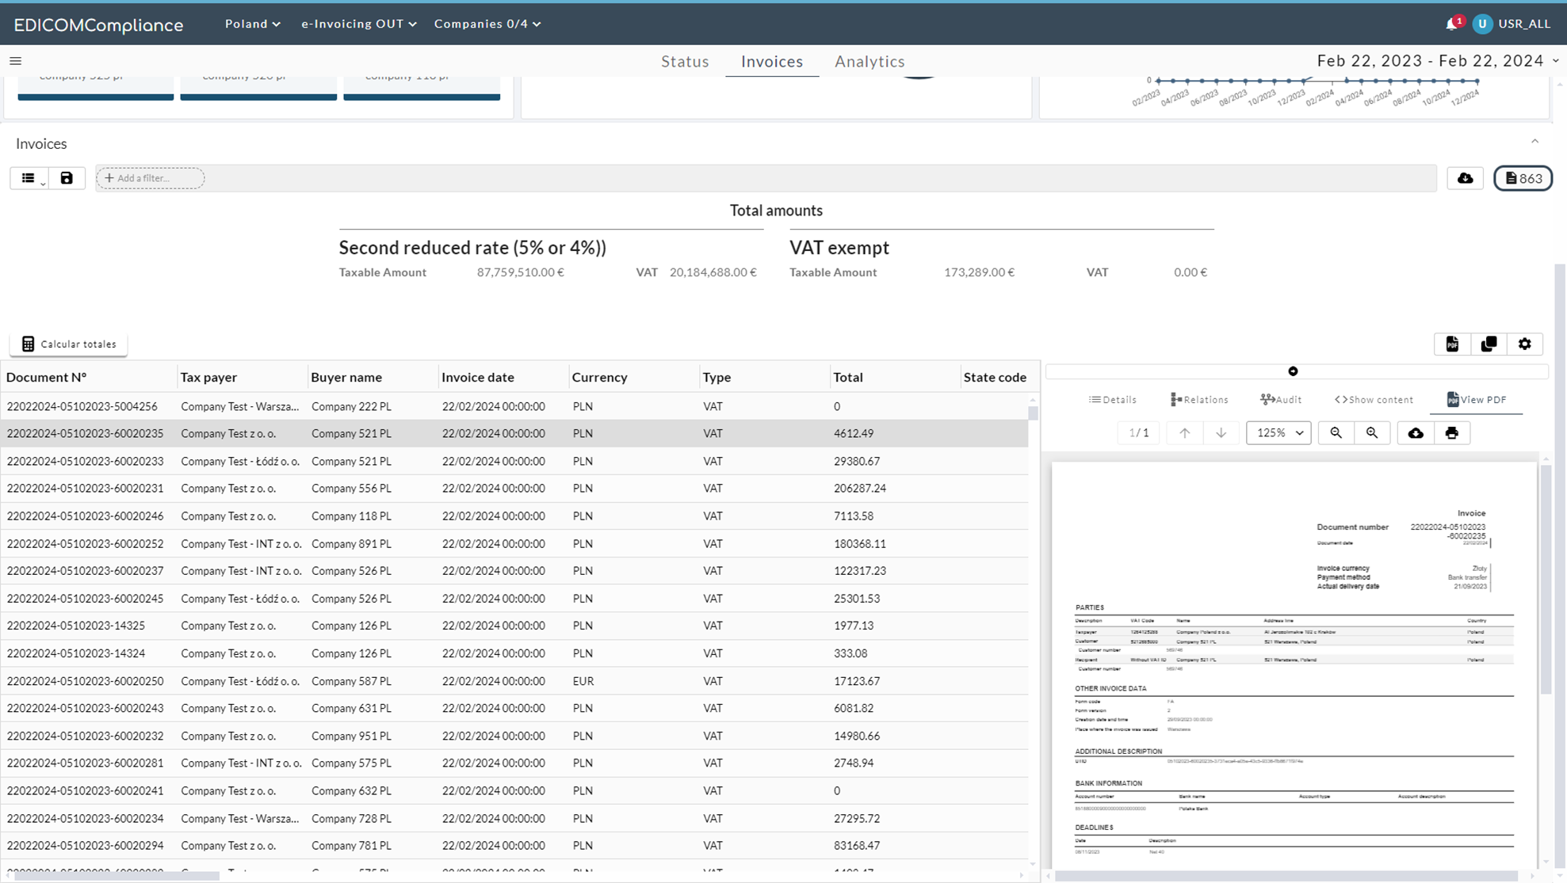
EDICOMCompliance
Notes:
The detail panel provides comprehensive information about any document. Multiple detail panels can be opened simultaneously for comparing the information across various messages, see the relationship with other linked documents, the audit trail of the document statuses, the structured format of the content (e.g. XML) and readable PDF formats. Searches can be conducted using various invoice metadata such as document reference, partners, invoice type, invoice status, sender, and recipient. The search results can be exported in formats like CSV, Excel, or PDF. Furthermore, this data extraction can be automated (e.g., weekly, monthly) and customised to fit Meta's specifications for integration with other tools (e.g. BI software).

Slide 16
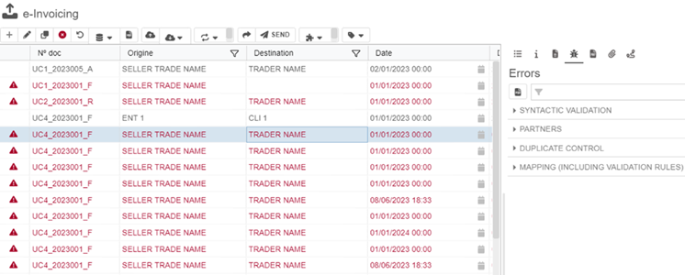
EDICOMCompliance

Slide 17
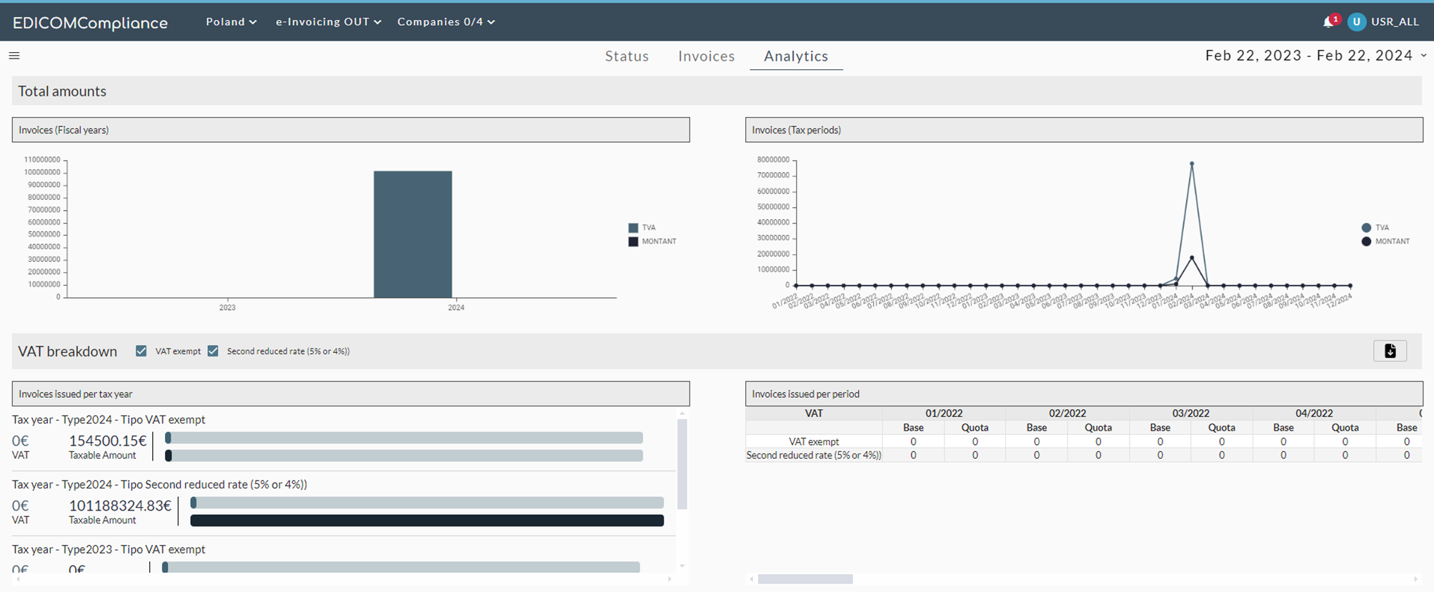
EDICOMCompliance

Slide 18
EDICOMCompliance

Slide 19
Contact
E-mail:
Ext:
ES: +34 961 366 565
DK: +45 32 745 487
SE: +46 850 513 095
NO: +47 21 029 019
FI: +358 931 581 564
NL: +31 207 086 282
BE: +32 787 900 52
UK: +44 20 3451 1784
IE: 353 1 4862 673
Let’s connect:

